Slide 1
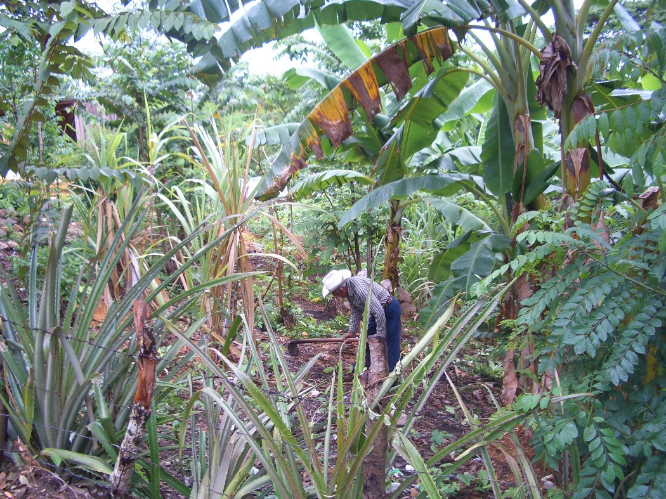
Non-Governmental Organizations and the Commodification of ethnicity and the environment in Copán, Honduras
Fredy R. Rodriguez Mejia
Michigan State University
American Anthropological Association Annual Meetings
December 2009

Slide 2
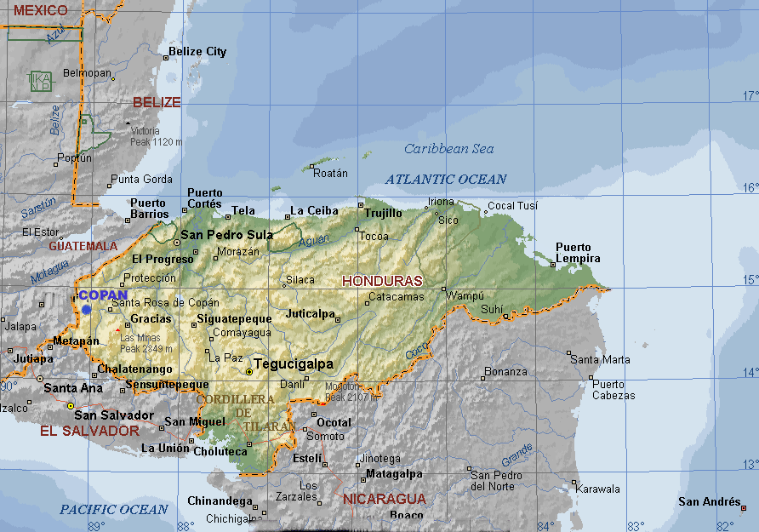
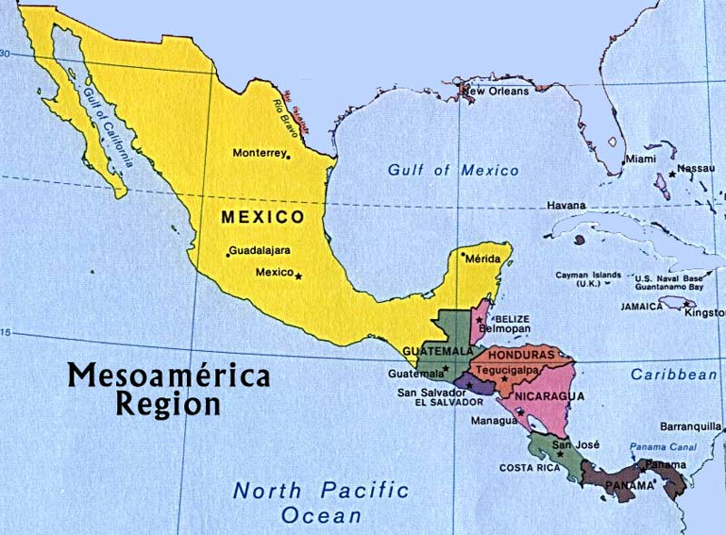

Slide 3
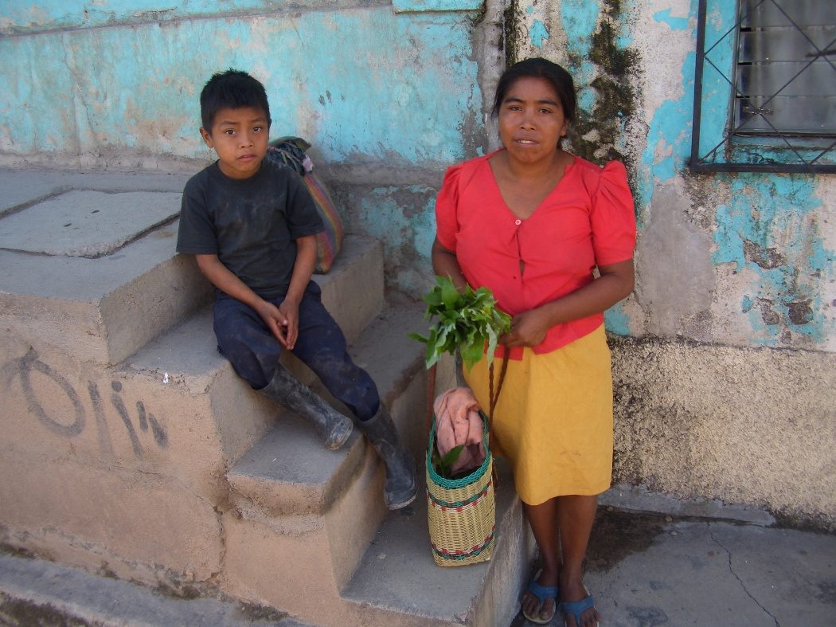

Slide 4
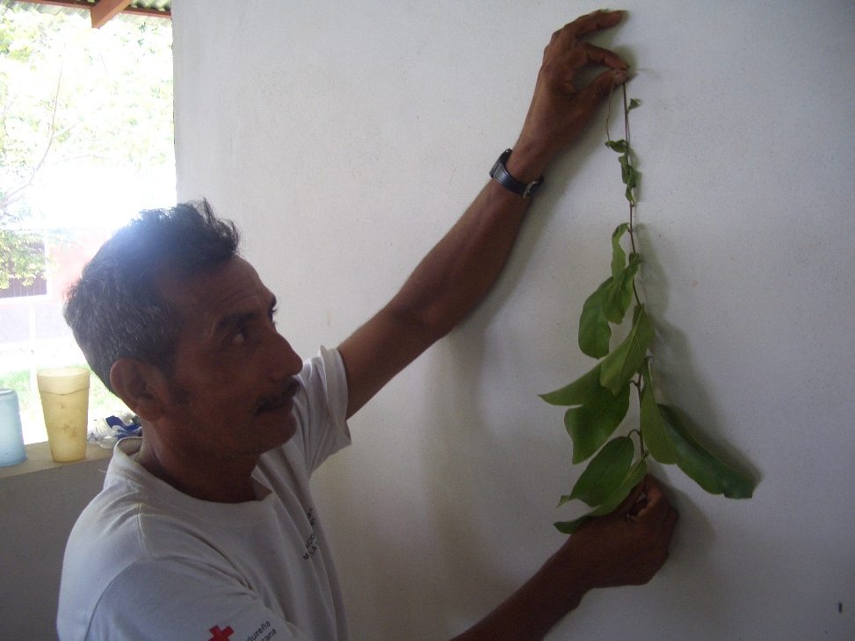

Slide 5
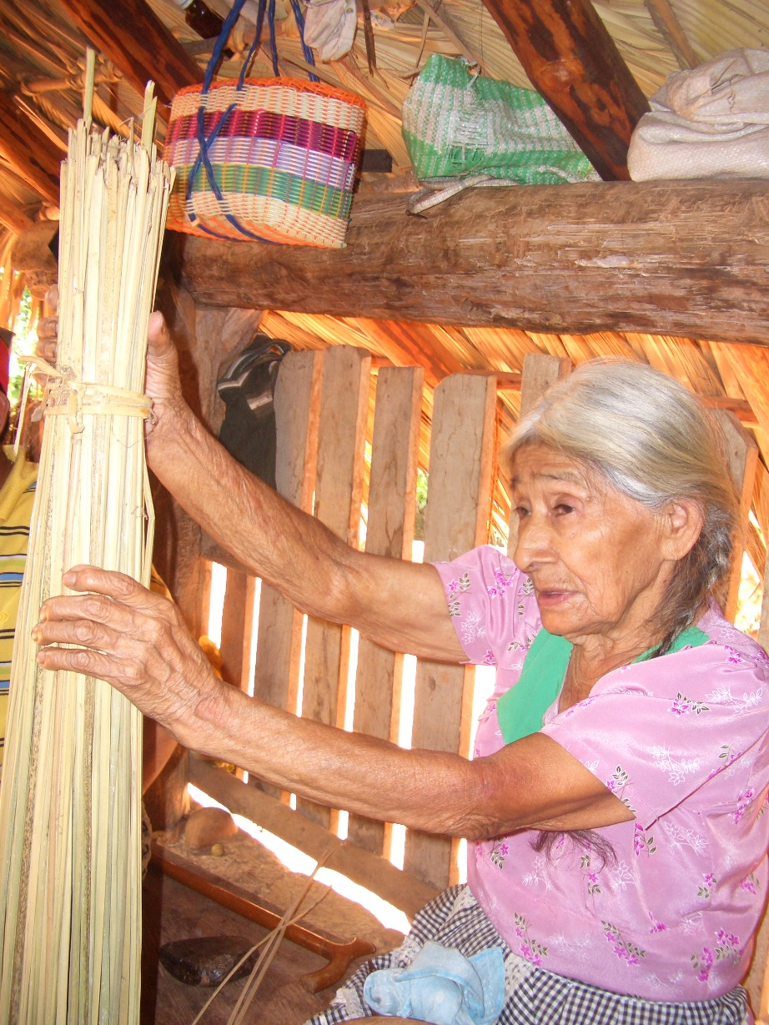

Slide 6
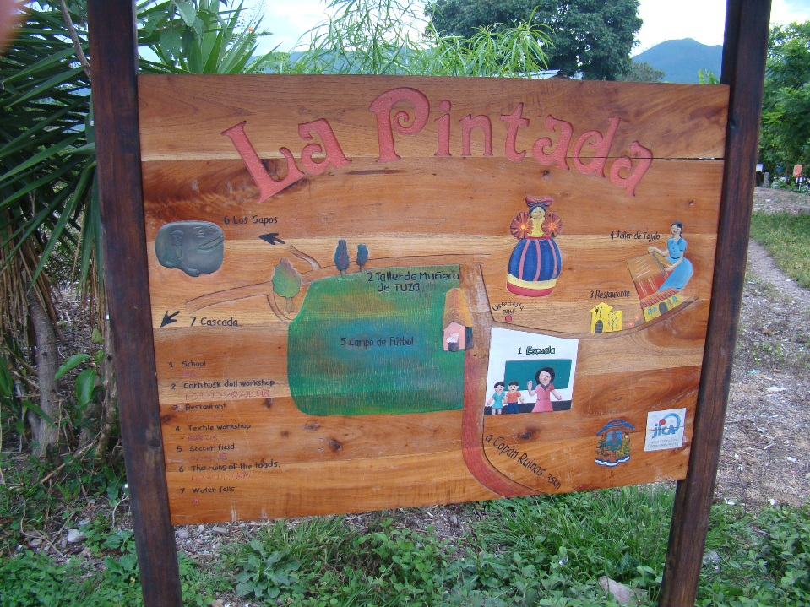
Wainwright (2008), Mortensen (2005) Castañeda (1996)

Slide 8
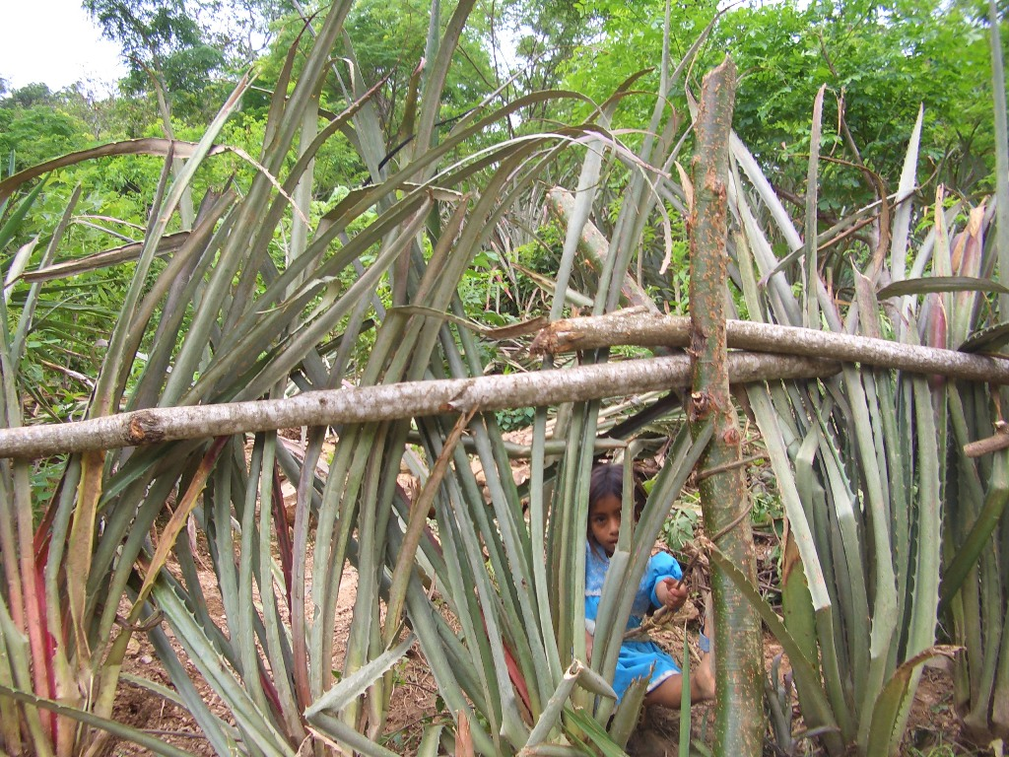

Slide 9
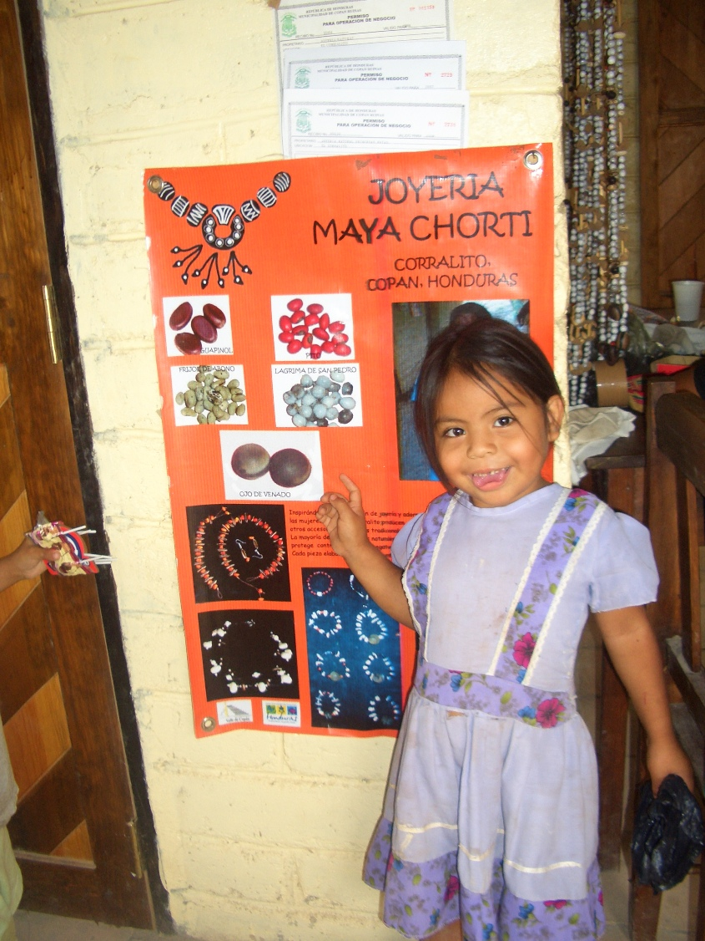
Mortensen (2005, 2009)

Slide 10
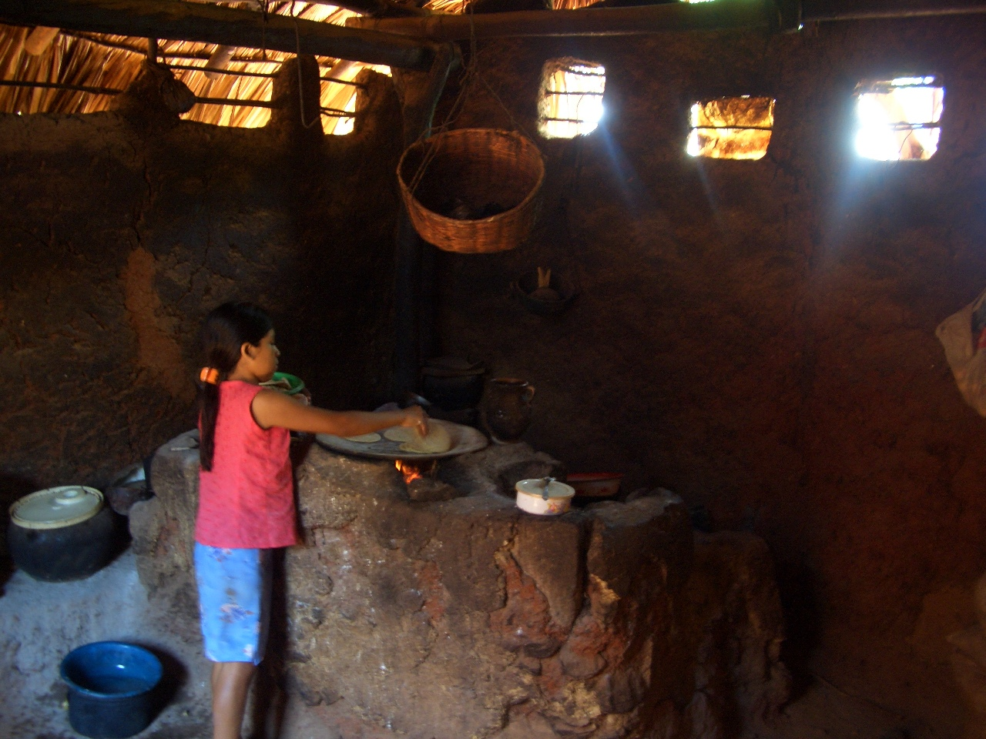
Metz ( 2006, 2009) Fischer (1999, 2001)

Slide 11
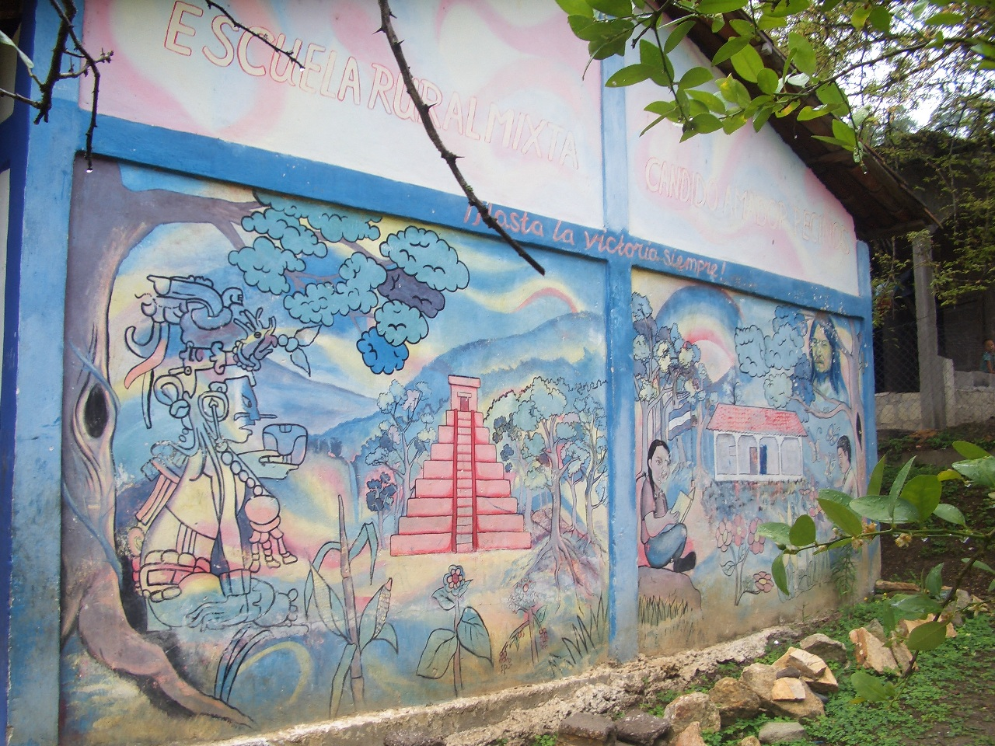
Metz, McNeil, and Hull (2009:6), Mortensen (2009)

Slide 12
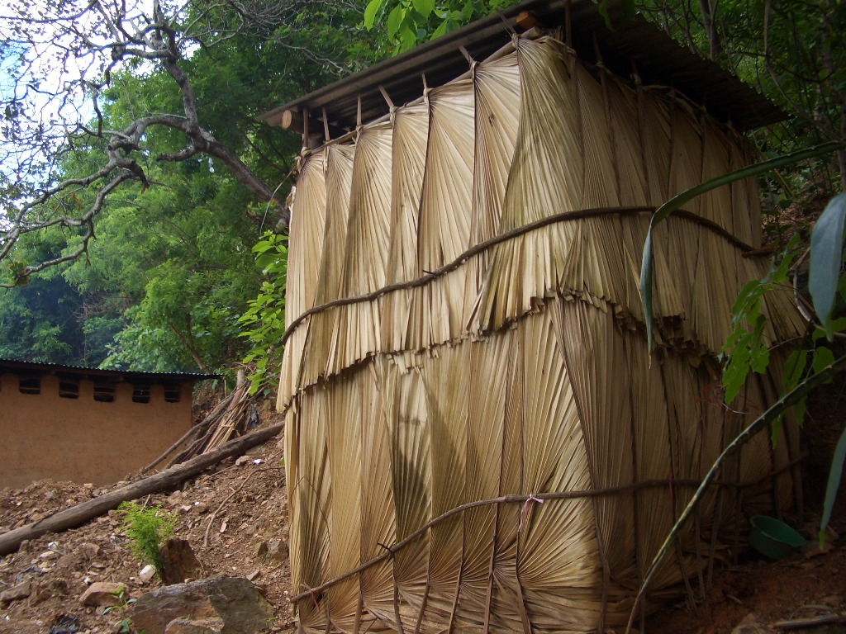
Escobar (1996), Little (2004)

Slide 13
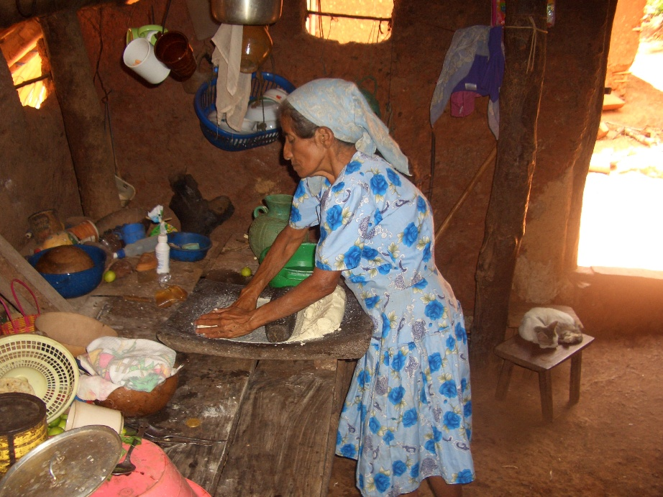
Metz (2006:141), Mortensen (2005)

Slide 14
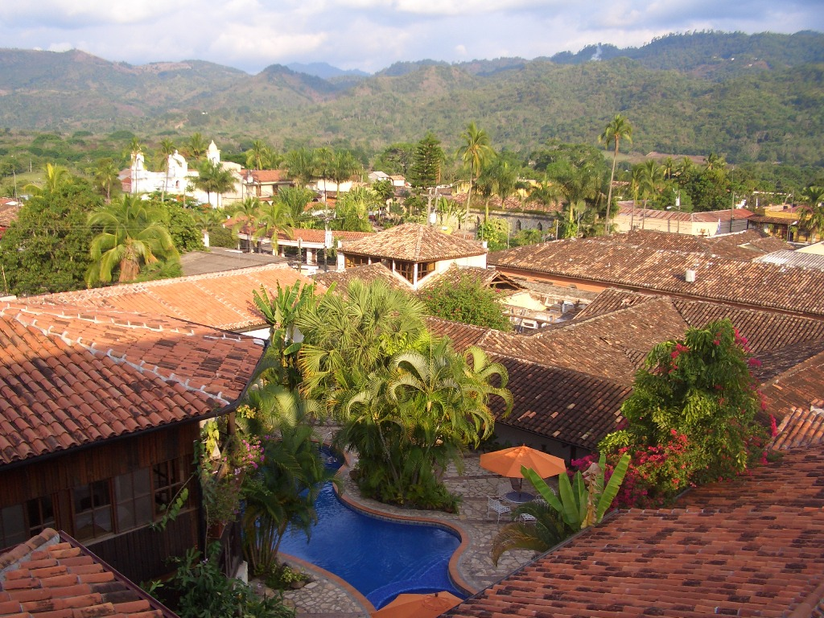

Slide 15
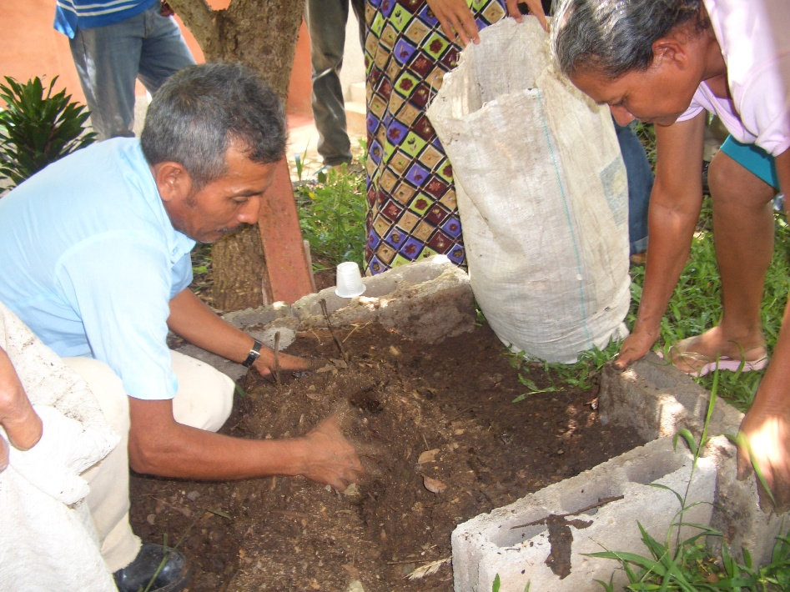

Slide 16
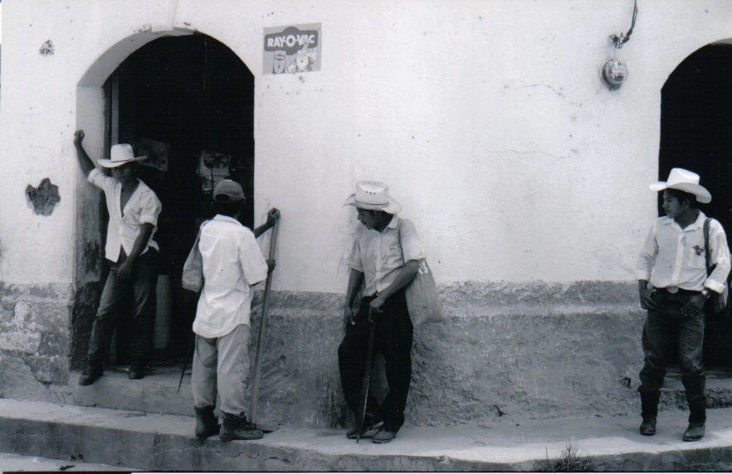

Slide 17
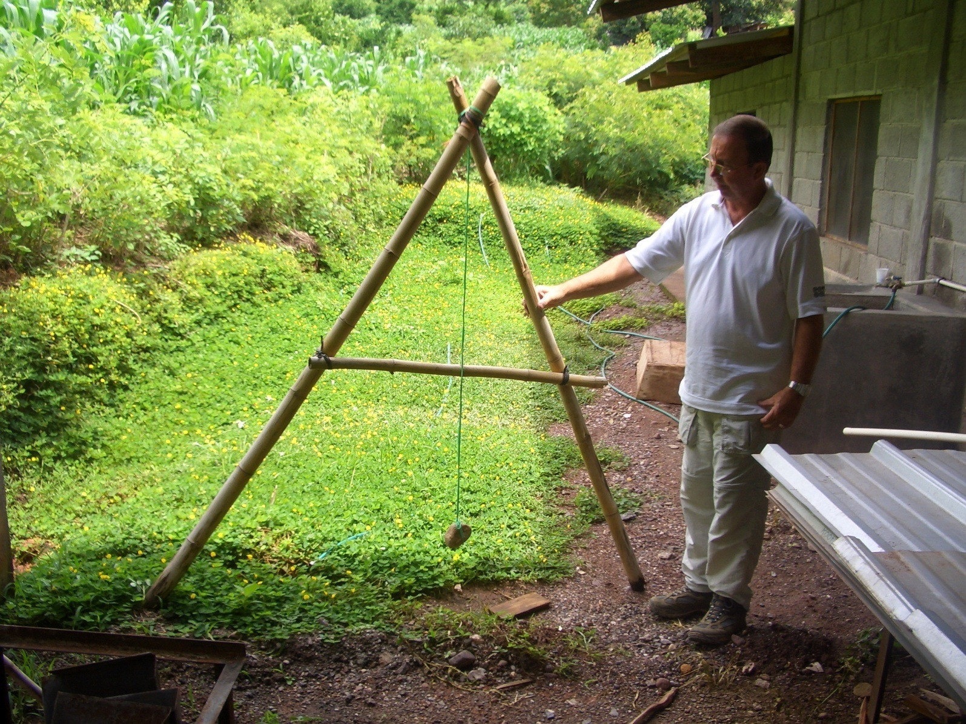

Slide 19
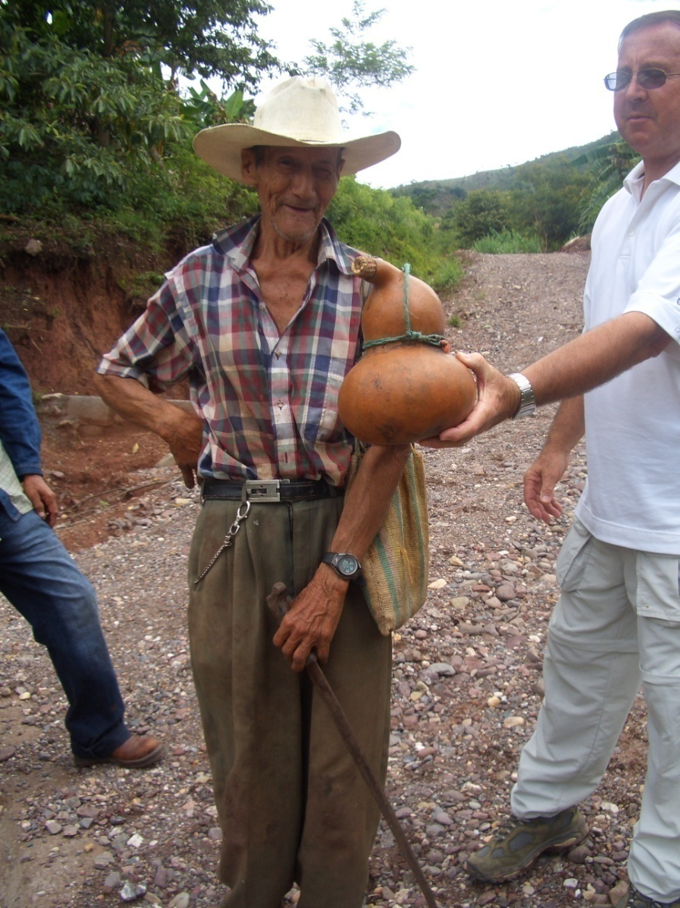
Postero and Zamosc (2006) Hale (2005)

Slide 20
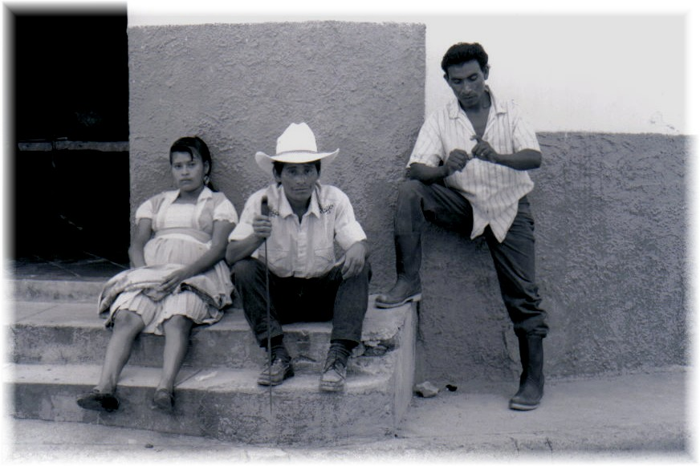
Warren (1998), Keck and Sikkink (1998), (Metz 2009), Loker (2009)

Slide 21
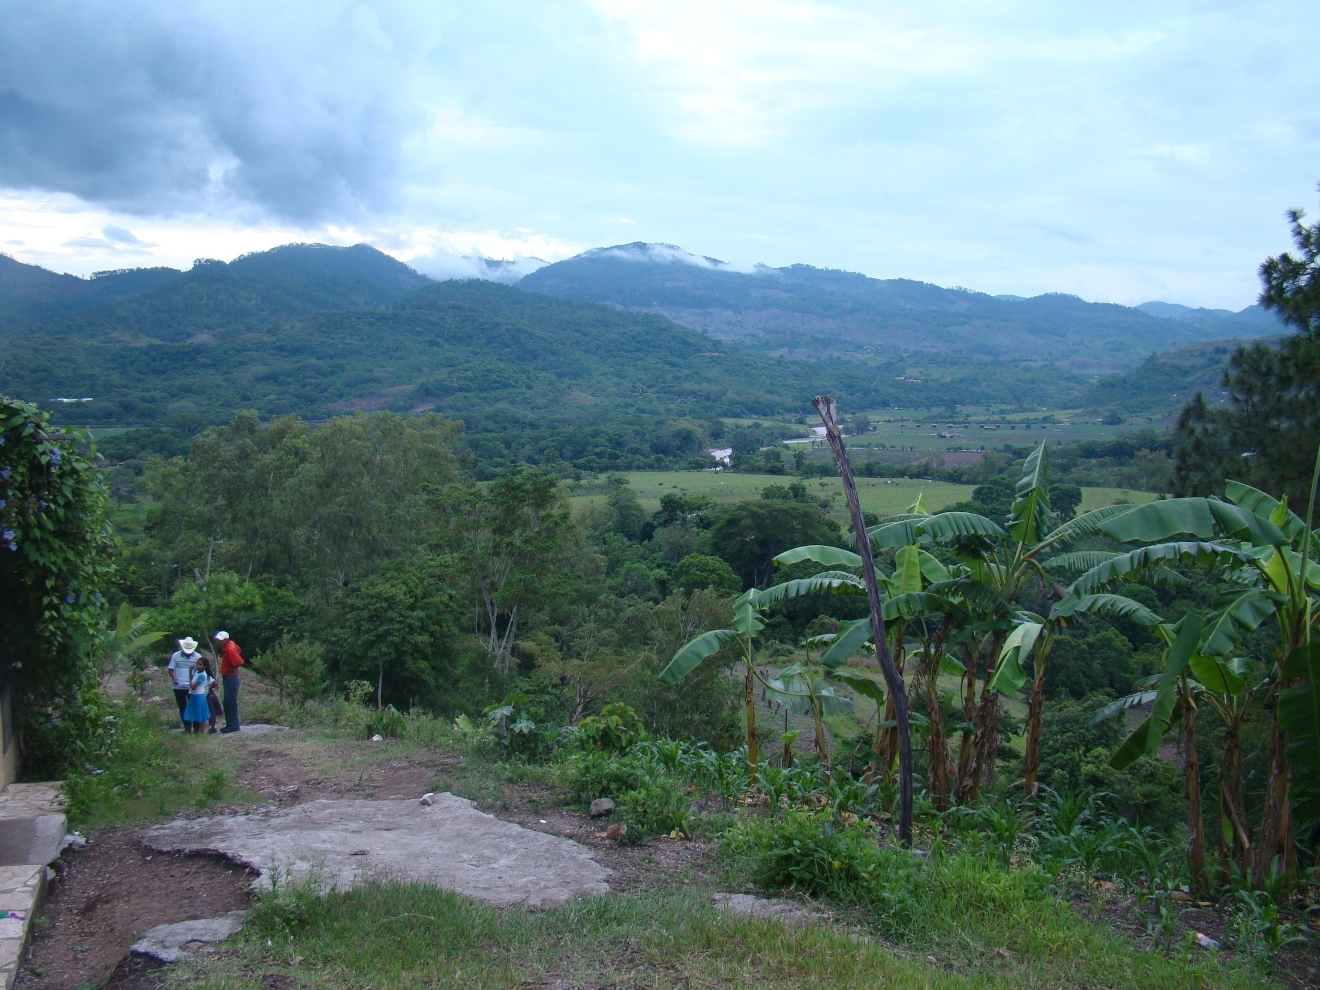

Slide 22
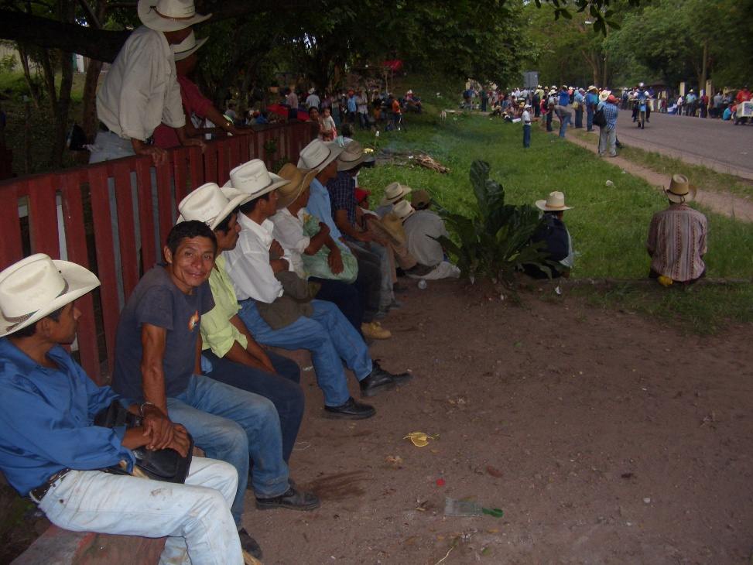
2008 strike in Copan archaeological park

